Slide 1
Kubernetes Basics
Training

Slide 2
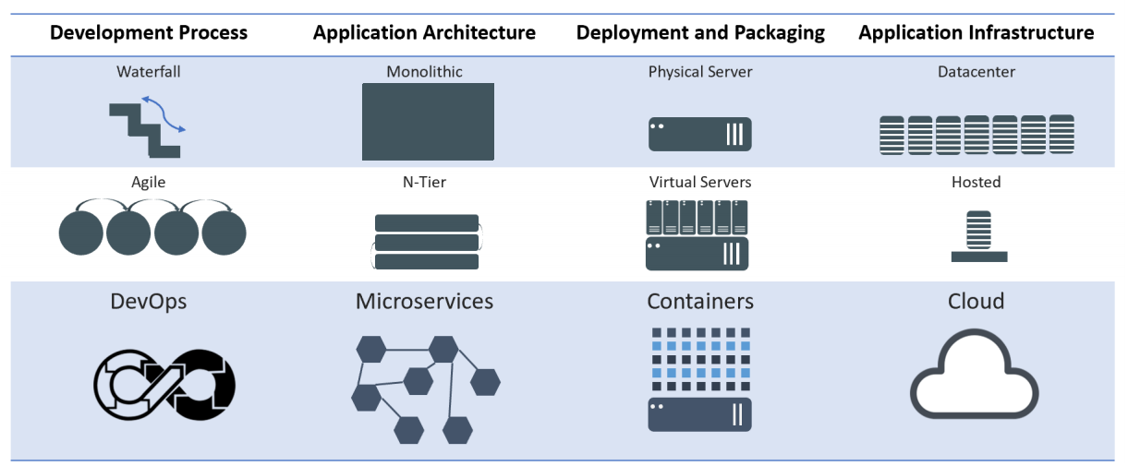
Evolution of Computing
Notes:
Mention WHY the evolution and benefits of adapting to new practices

Slide 3
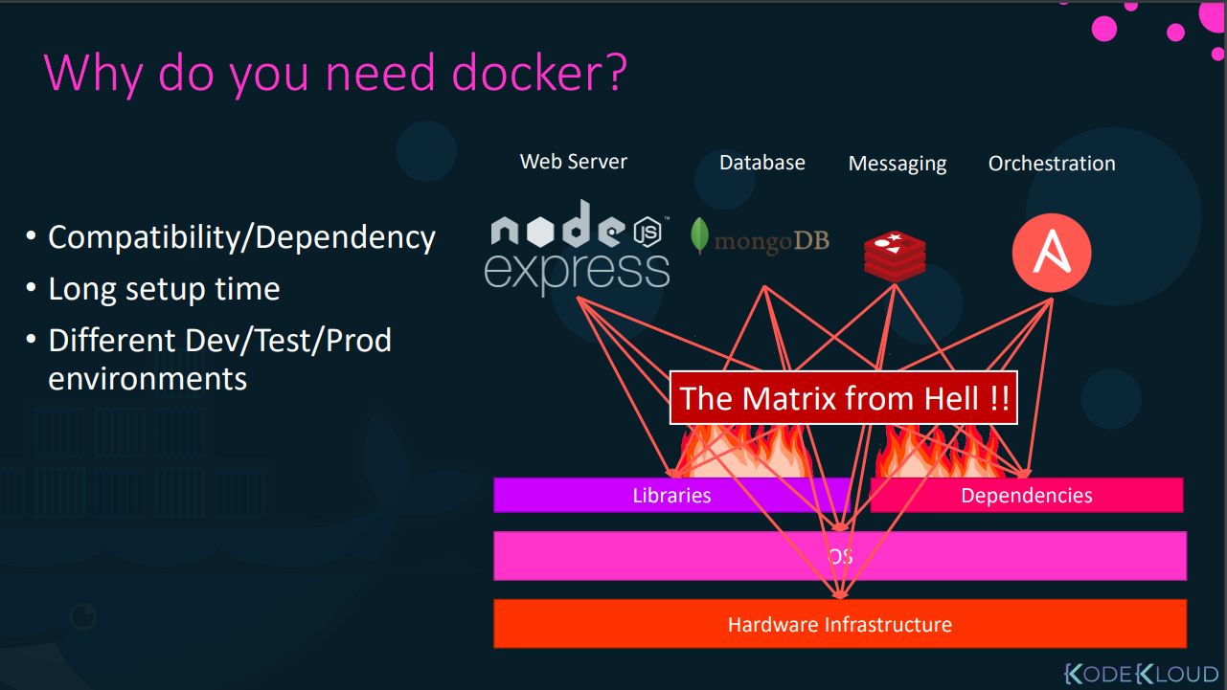

Slide 4
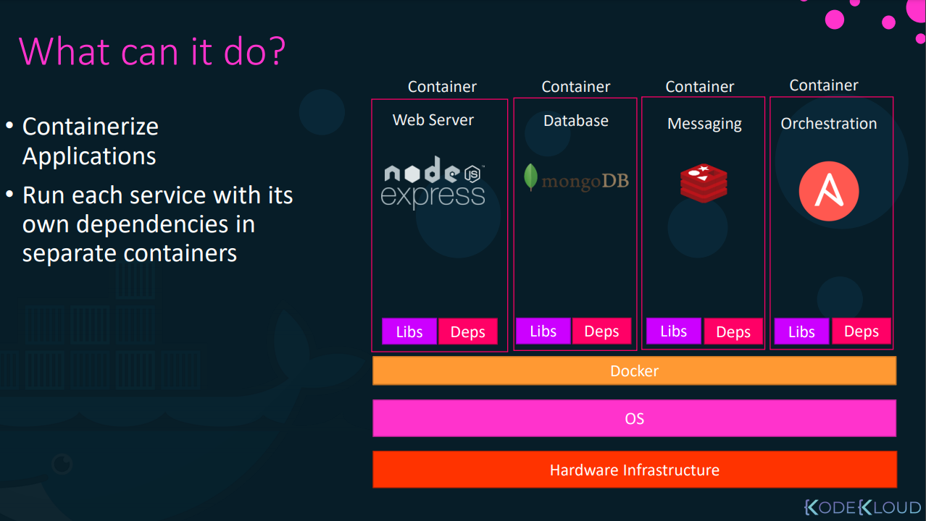

Slide 5
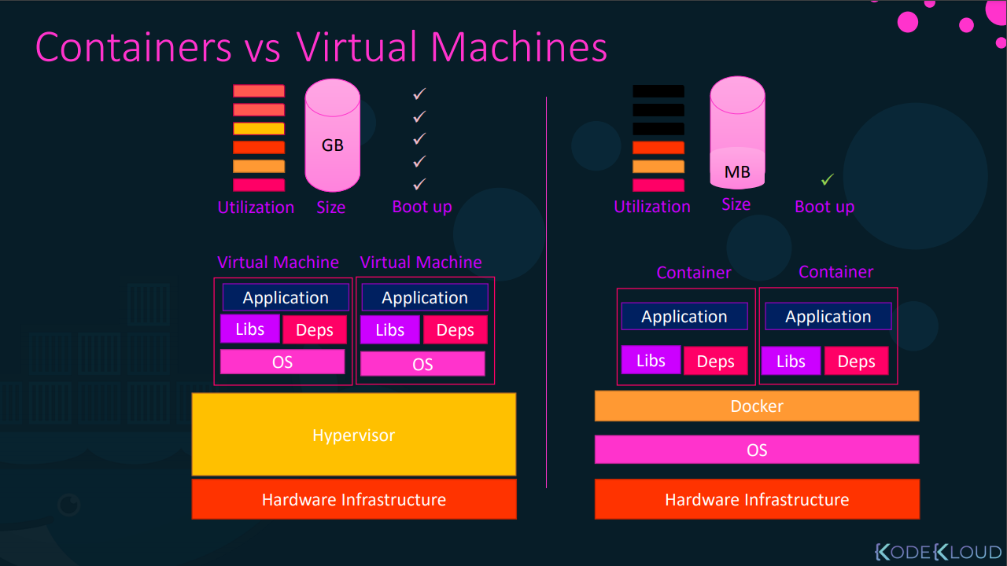

Slide 6
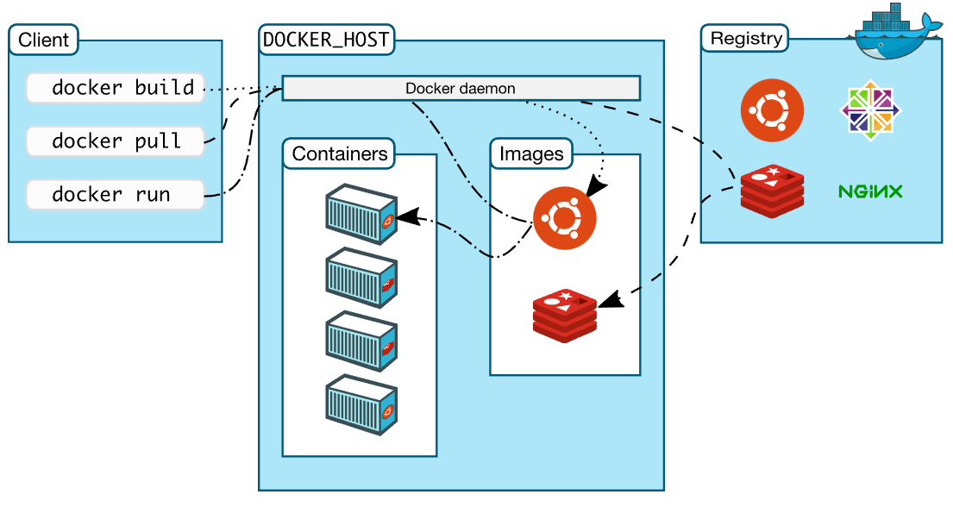
Docker architecture

Slide 7
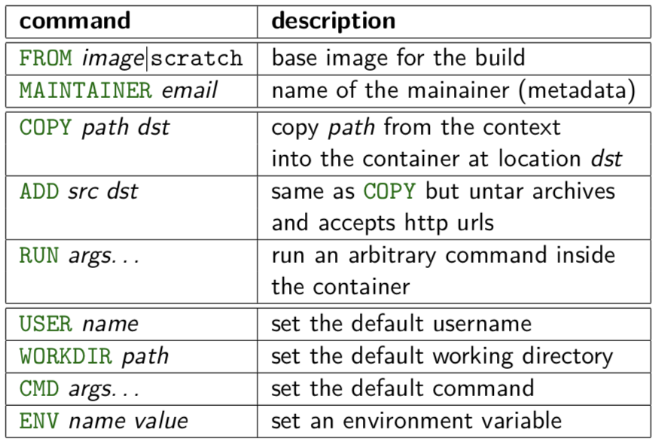
Dockerfile
https://docs.docker.com/engine/reference/builder/

Slide 8
Architecture Overview
Masters - Acts as the primary control plane for Kubernetes. Masters are responsible at a minimum for running the API Server, scheduler, and cluster controller. They commonly also manage storing cluster state, cloud-provider specific components and other cluster essential services.
Nodes - Are the ‘workers’ of a Kubernetes cluster. They run a minimal agent that manages the node itself, and are tasked with executing workloads as designated by the master.

Slide 9
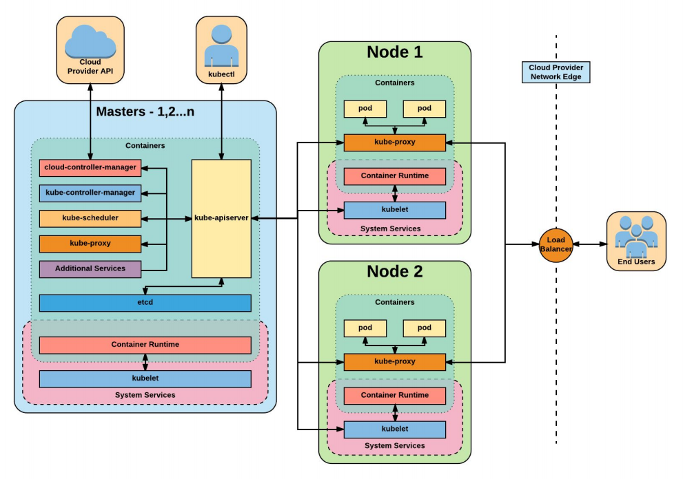

Slide 10
Installation
Install Minikube and Kubectl
https://github.com/arjunachari12/install-jenkins-container/blob/main/kubernetes.md

Slide 11
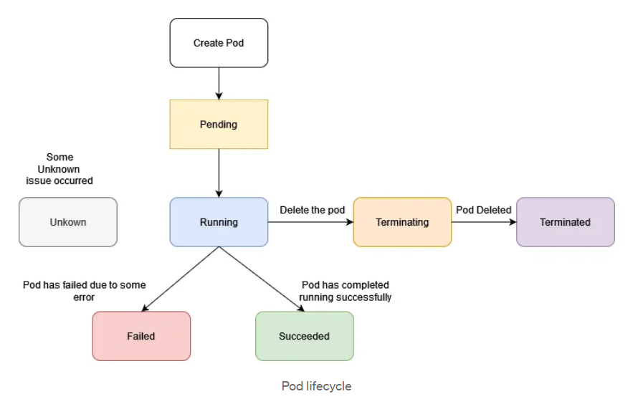
Pods lifecycle

Slide 12
Exercise: Run image as pod
Hands-on steps:
Step 1: Open VS code and create new folder
Step 2 : write manifest file pod.yml, copy code from below link
https://github.com/arjunachari12/k8s-learn/blob/main/pod.yml
Step 3: Execute pod.yml file using below command
kubectl create -f pod.yml
Step 4: You should see pod created message
Step 5: run below commands
kubectl get pod
kubeclt describe pod pod
kubectl delete pod

Slide 13
Assignment: Run multiple images as pod
Hands-on steps:
Step 1: Open VS code and create new folder
Step 2 : write manifest file pod.yml, copy code from below link
https://github.com/arjunachari12/k8s-learn/blob/main/pod2.yml
Step 3: Execute pod.yml file using below command
kubectl create -f pod2.yml
Step 4: You should see pod created message
Step 5: run below commands
kubectl get pod
kubeclt describe pod pod1
kubectl delete pod pod1

Slide 14
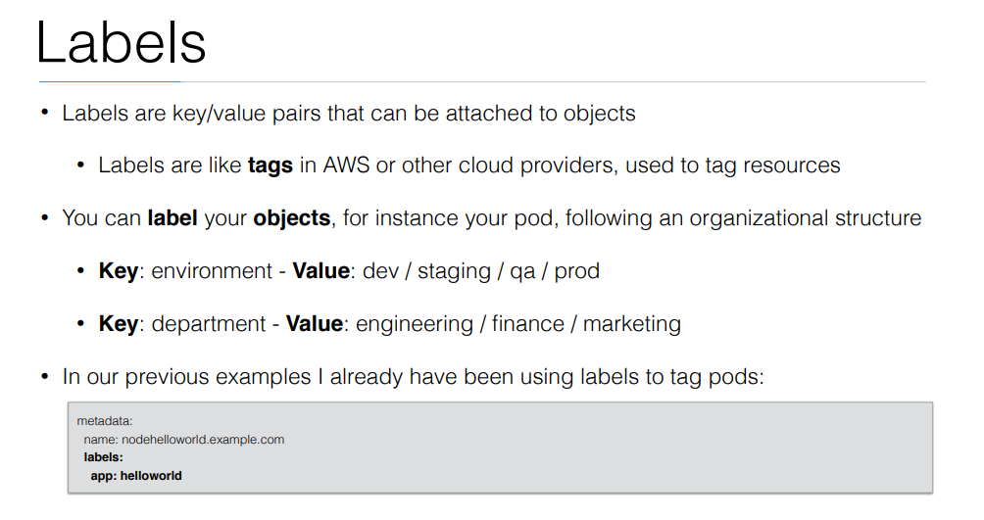

Slide 15
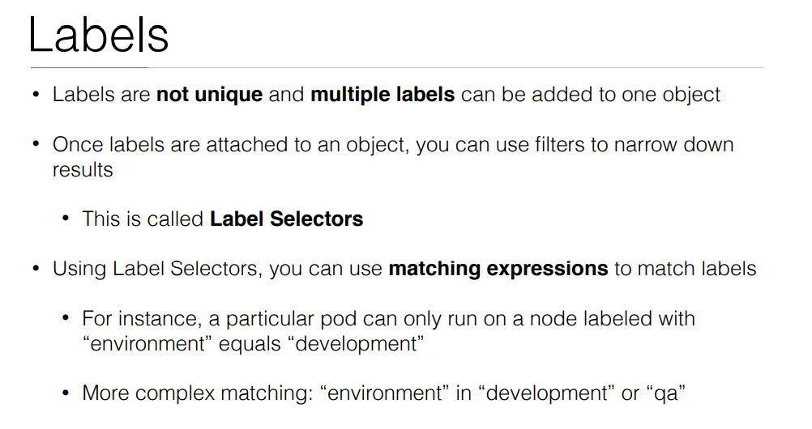

Slide 16
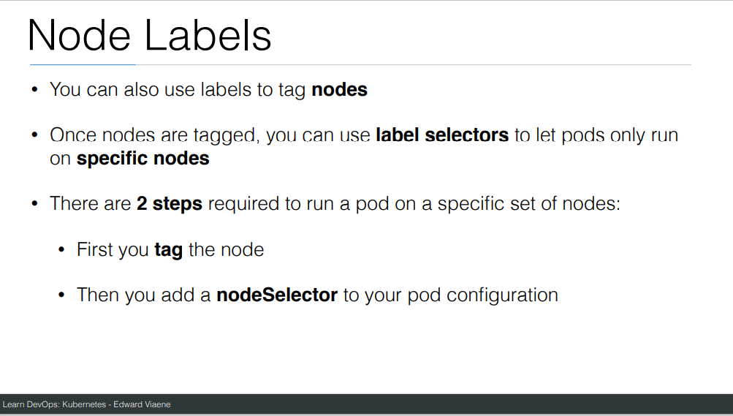

Slide 17
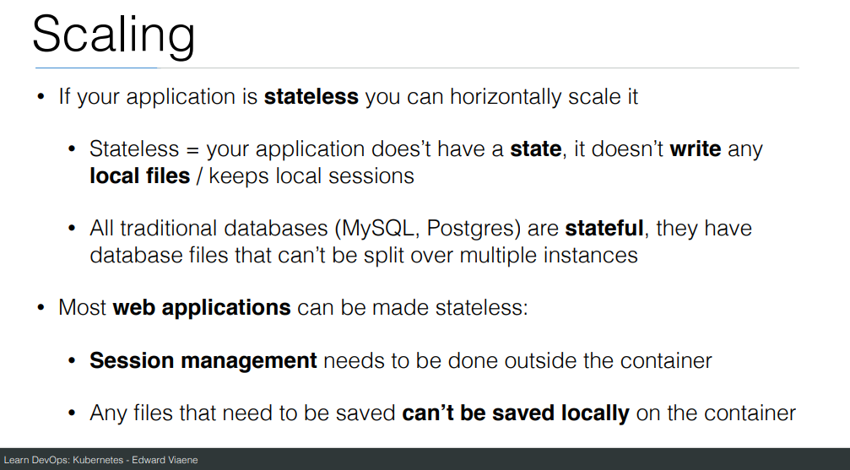

Slide 18
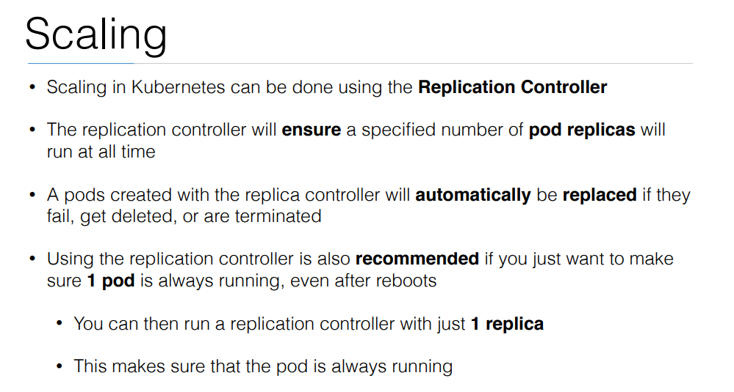

Slide 19
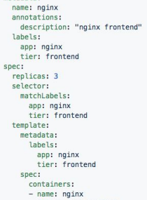
ReplicaSet
Generated ReplicaSet from Deployment spec.

Slide 20
Replicaset
kubectl create -f helloworld_replicaset.yaml
kubectl get rs
kubectl autoscale rs helloworld-controller --max=5
kubectl delete rs helloworld-controller
kubectl edit pods helloworld-controller-9jlsq

Slide 21
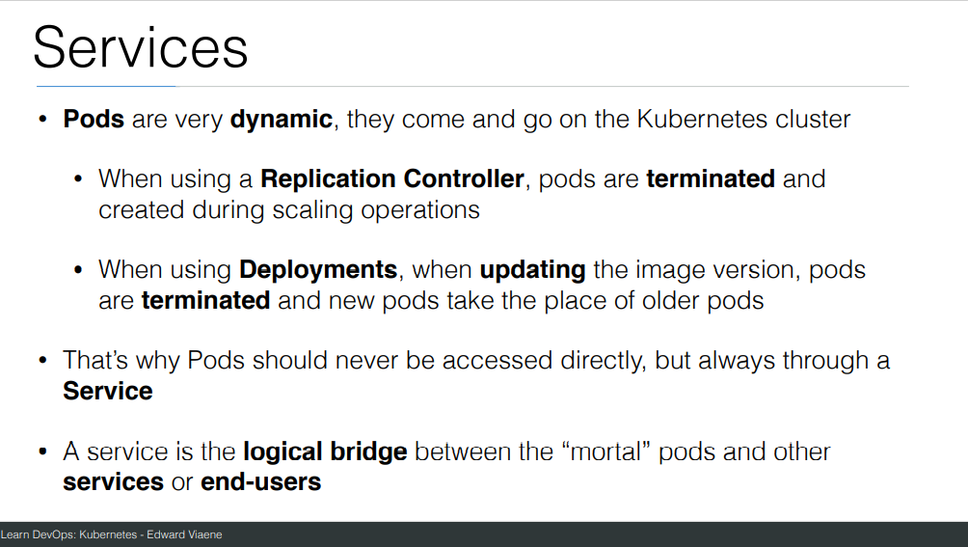

Slide 22
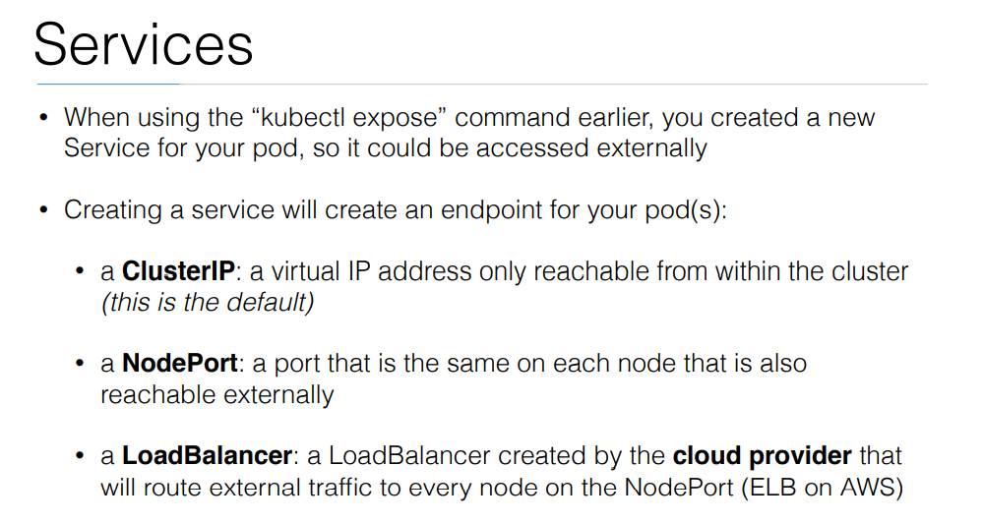

Slide 23
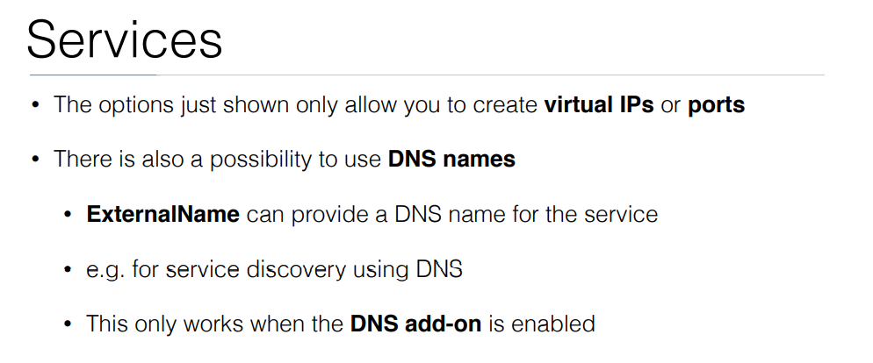

Slide 24
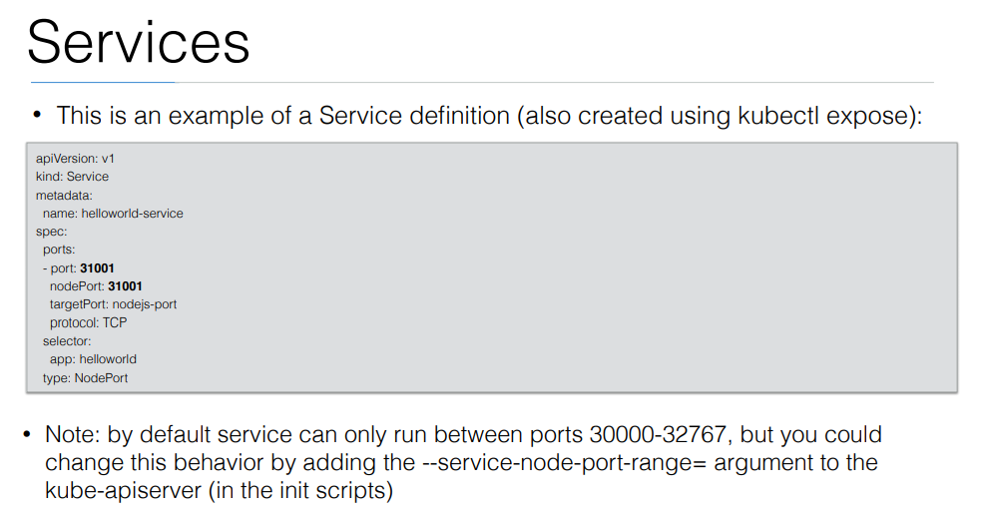

Slide 25
Exercise: Run image as pod
Hands-on steps:
Step 1: Open VS code and create new folder
Step 2 : write manifest file pod3.yml, copy code from below link
https://github.com/arjunachari12/k8s-learn/blob/main/pod3.yml
Step 3: Execute pod.yml file using below command
kubectl create -f pod3.yml
Step 4: You should see pod created message
Step 5: run below commands
kubectl get pod
kubeclt describe pod pod3

Slide 26
Exercise: Expose pod as Service
Hands-on steps:
Step 1: Open VS code and create new folder
Step 2 : write manifest file pod3-service.yml, copy code from below link
https://github.com/arjunachari12/k8s-learn/blob/main/pod3-service.yml
Step 3: Execute pod3-service.yml file using below command
kubectl create -f pod3-service.yml
Step 4: You should see pod created message

Slide 27
Exercise: Expose pod as Service
Hands-on steps:
Step 5: run below commands
kubectl get pod
kubeclt describe pod pod3
kubectl get svc
minikube service helloworld-service --url
kubectl describe svc helloworld-service
kubectl describe svc
Kubectl get svc
kubectl delete svc helloworld-nodeport-service.yml

Slide 28
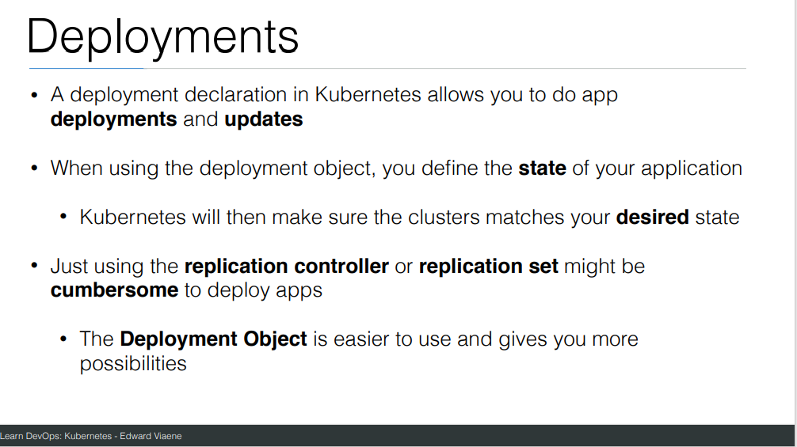

Slide 29
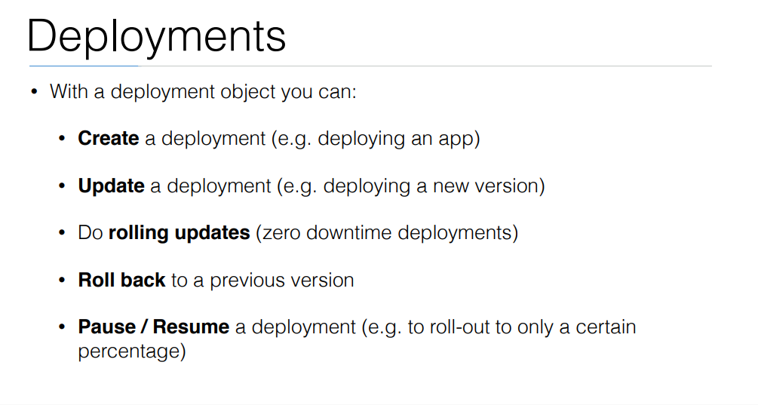

Slide 30
commands
Create a file called helloworld-deployment.yaml
Copy content from https://github.com/arjunachari12/k8s-learn/blob/main/helloworld-deployment.yml
kubectl create -f helloworld-deployment.yaml
kubectl get deployments
kubectl get rs
kubectl get pods
kubectl get pods --show-labels
kubectl rollout status deployment/helloworld-deployment

Slide 31
commands
Created new version of docker image and uploaded in docker hub
kubectl expose deployment helloworld-deployment --type=NodePort
kubectl get svc
minikube service helloworld-deployment --url
Curl url
kubectl set image deployment/helloworld-deployment k8s-demo=arjunachari12/k8s-demo:2
see
Curl to see new version

Slide 32
commands
kubectl get pods
kubectl rollout history deployment/helloworld-deployment
kubectl get pods
kubectl rollout undo deployment/helloworld-deployment
Curl again #modify history count
kubectl edit deployment/helloworld-deployment

Slide 33
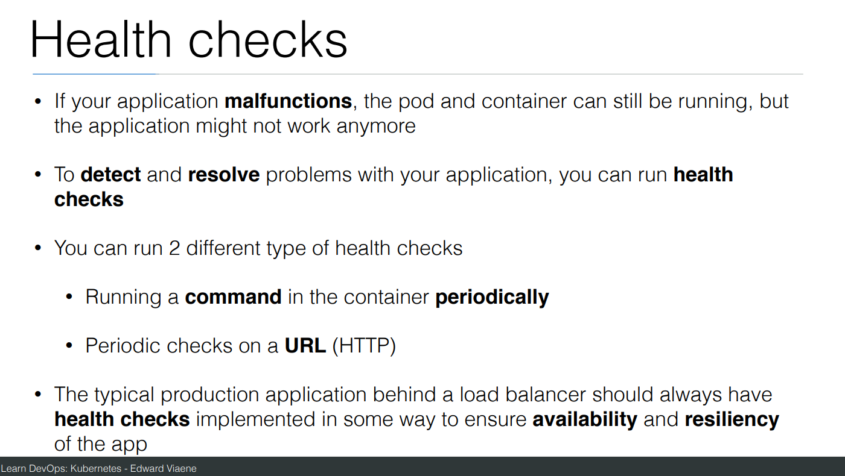

Slide 34
Commands
Create a file helloworld-healthcheck.yml
kubectl create -f helloworld-healthcheck.yml
kubectl describe pod helloworld-deployment-7cfbb8fccf-78bxk
kubectl edit deployment/helloworld-deployment
#This will immediately run
kubectl create -f helloworld-healthcheck.yml && watch -n1 kubectl get pods

Slide 35
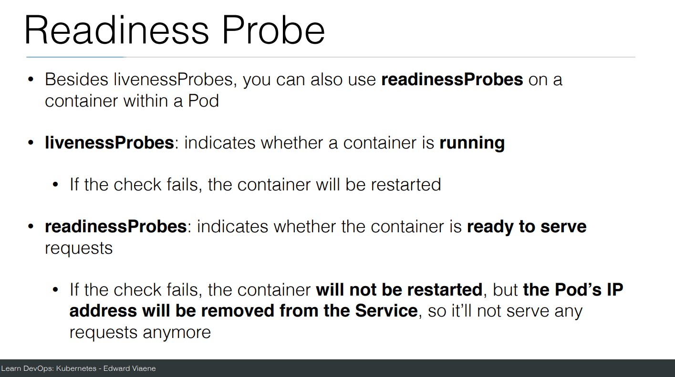

Slide 36
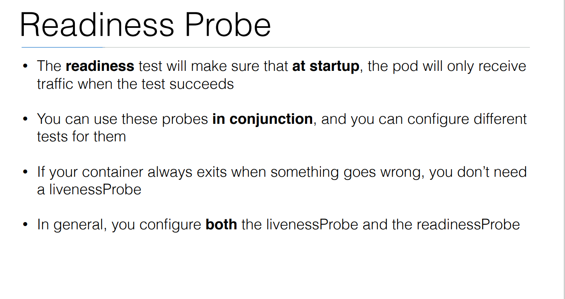

Slide 37
Commands
Create a file helloworld-liveness-readiness.yml
kubectl create -f helloworld-liveness-readiness.yml && watch -n1 kubectl get pods

Slide 38
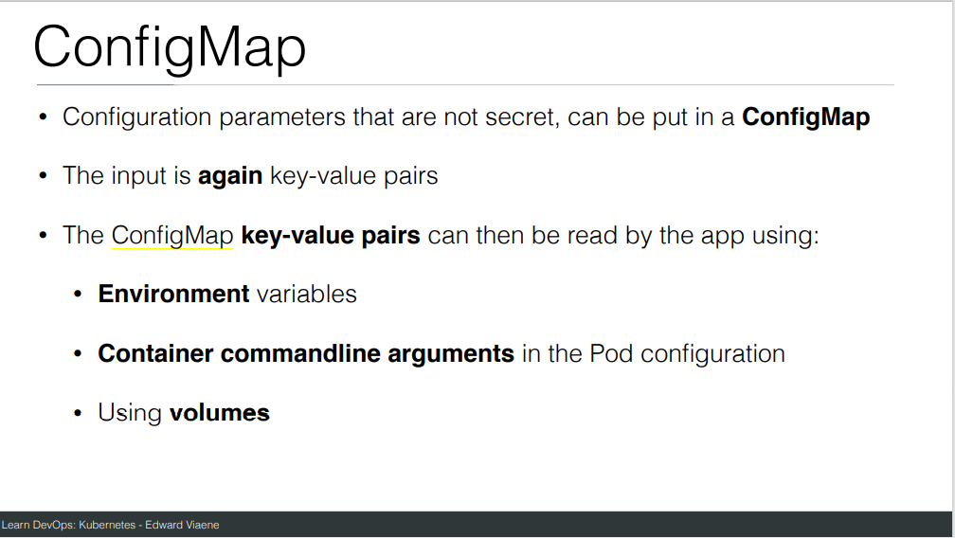

Slide 39
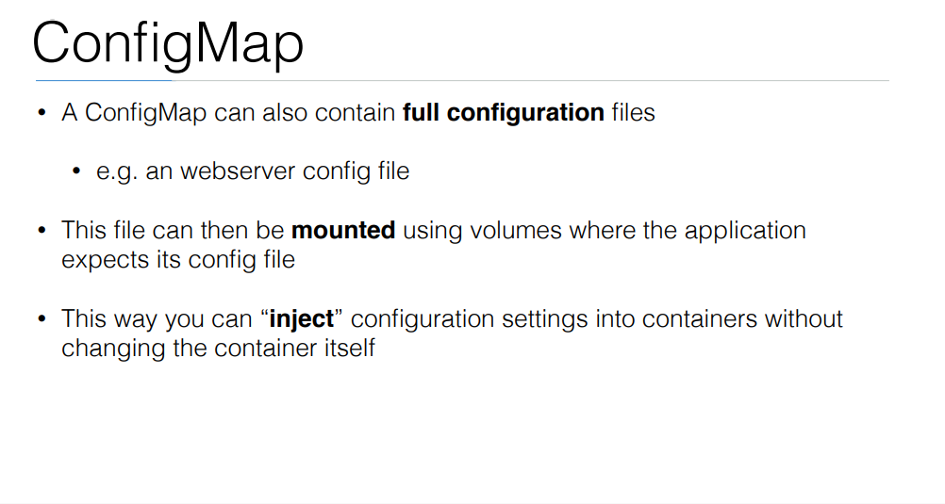

Slide 40
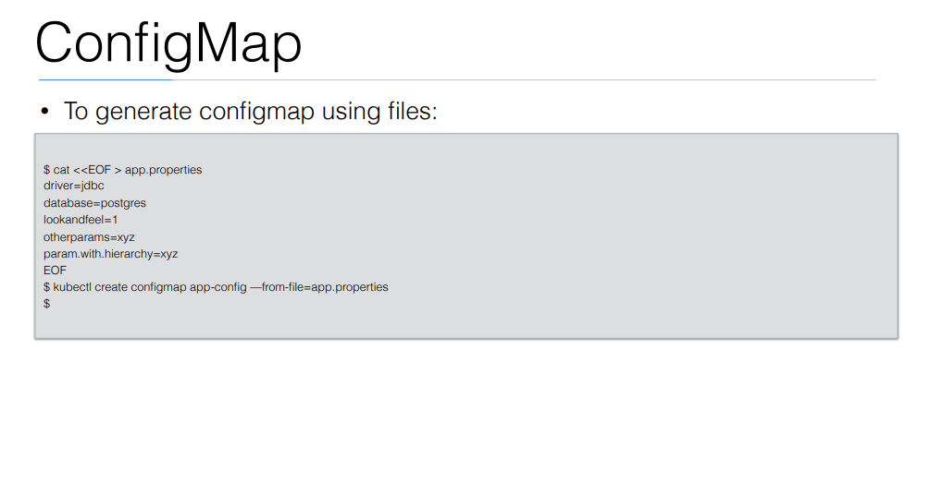

Slide 41
Exercise: Configmap
Create file and copy below content
https://github.com/arjunachari12/k8s-learn/blob/main/pod-configmap.yml
Run the file

Slide 42
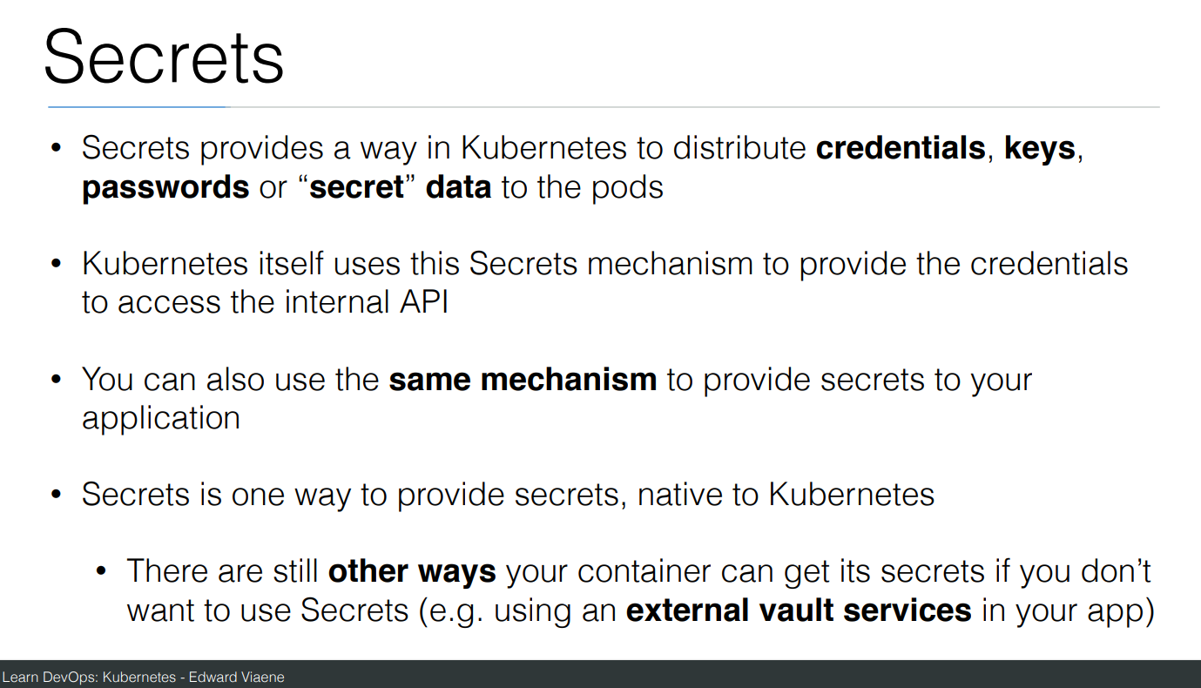

Slide 43
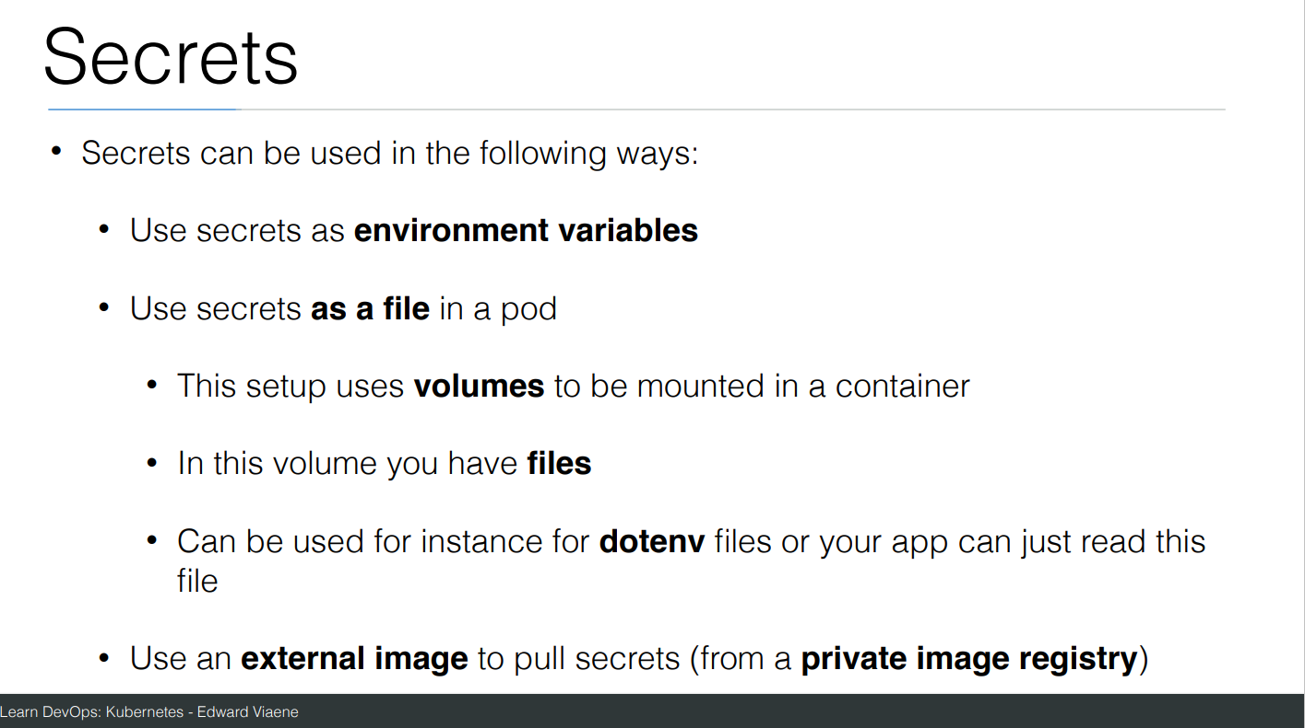

Slide 44
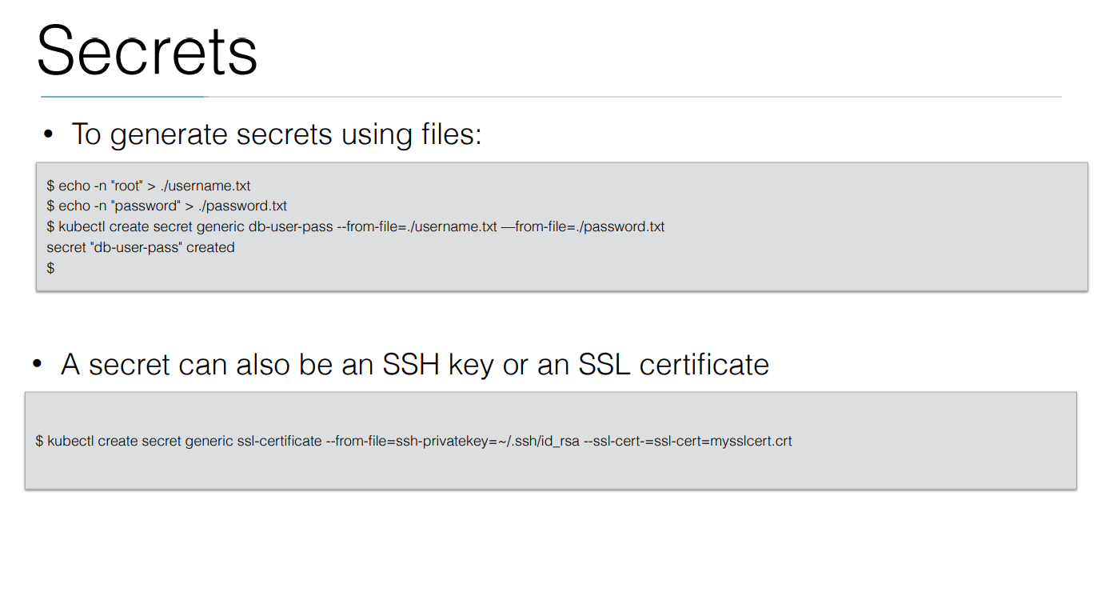

Slide 45
Exercise: Secrets
Create file and copy below content
https://github.com/arjunachari12/k8s-learn/blob/main/secrets.yaml
Run the file
Create file and copy below content
https://github.com/arjunachari12/k8s-learn/blob/main/database.yml
Run the file

Slide 46
Volume
On-disk files in a container are ephemeral, which presents some problems for non-trivial applications when running in containers.
One problem occurs when a container crashes or is stopped.
Container state is not saved so all of the files that were created or modified during the lifetime of the container are lost.
During a crash, kubelet restarts the container with a clean state. Another problem occurs when multiple containers are running in a Pod and need to share files.
It can be challenging to setup and access a shared filesystem across all of the containers

Slide 47
Ephemeral Volumes
Some application need additional storage but don't care whether that data is stored persistently across restarts.
For example, caching services are often limited by memory size and can move infrequently used data into storage that is slower than memory with little impact on overall performance.
Other applications expect some read-only input data to be present in files, like configuration data or secret keys.
Ephemeral volumes are designed for these use cases. Because volumes follow the Pod's lifetime and get created and deleted along with the Pod, Pods can be stopped and restarted without being limited to where some persistent volume is available.

Slide 48
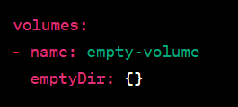
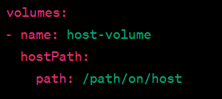
Types of ephemeral volumes
EmptyDir:
A simple volume that is initially empty when a pod is created.
Data in an EmptyDir volume is ephemeral and is lost when the pod is deleted or rescheduled.
HostPath:
Mounts a file or directory from the host node's filesystem into the pod.
Useful for accessing local files or sharing data between the host and the pod.

Slide 49
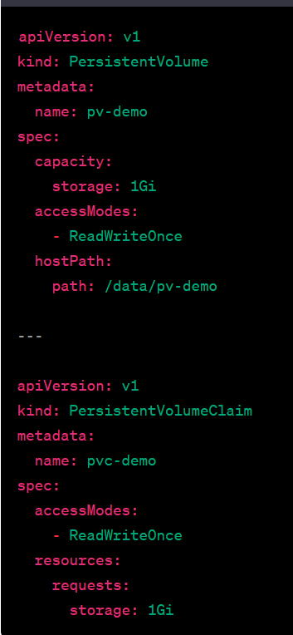
Types of ephemeral volumes
PersistentVolume (PV) and PersistentVolumeClaim (PVC):
PV represents a piece of networked storage in the cluster.
PVC is a request for storage by a user.
PVs and PVCs enable data persistence beyond the pod lifecycle and are used for more advanced storage scenarios.

Slide 50
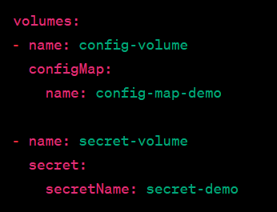
Types of ephemeral volumes
ConfigMap and Secret Volumes
Allow pods to consume ConfigMaps or Secrets as volumes.
Useful for configuration data or sensitive information.

Slide 51
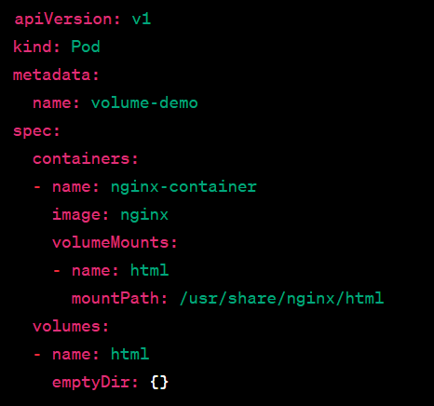
Volume Mounts
Volume mounts are where volumes are attached within the container's filesystem.
Containers in the same pod can share data through volume mounts.
https://kubernetes.io/docs/tasks/configure-pod-container/configure-persistent-volume-storage/

Slide 52
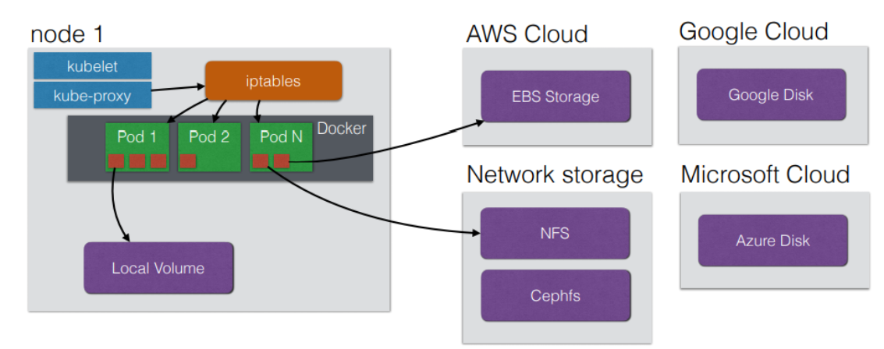
StorageClass
a StorageClass is an abstraction that defines the properties and parameters for dynamically provisioning storage volumes.

Slide 53
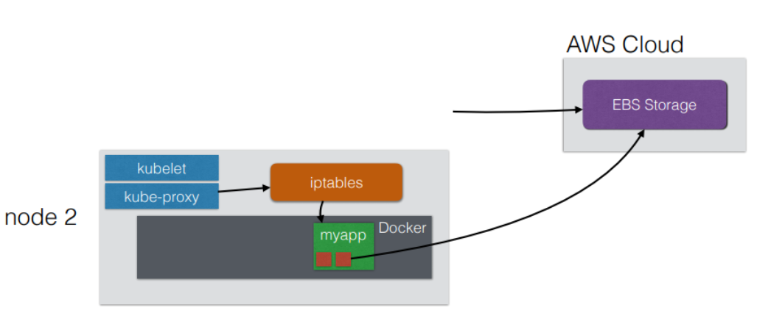
StorageClass
It allows users to describe the "class" of storage they need and enables dynamic provisioning based on that description. StorageClass provides a way to abstract the underlying storage infrastructure, making it easier to manage and scale storage in a Kubernetes cluster.

Slide 54
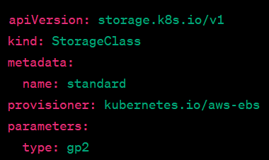
StorageClass
Dynamic Provisioning: StorageClass enables dynamic provisioning of persistent volumes (PVs). When a user requests storage and doesn't specify a particular PV, Kubernetes uses the StorageClass to dynamically provision a suitable PV.
Parameters: StorageClasses can include parameters that define the characteristics of the storage to be provisioned. These parameters are specific to the storage provider or the storage system being used.

Slide 55
Networking in Kubernetes
Networking in Kubernetes is designed to allow communication between various components within the cluster, including pods, services, and external resources.
Pod-to-Pod Communication (Pod Networking)
Pods are the basic units in Kubernetes, and they need to communicate with each other, often across nodes.
Kubernetes ensures that:
Every pod gets its own unique IP address.
Pods can communicate with each other without NAT (Network Address Translation).
The IP assigned to a pod is only valid for the pod’s lifetime, so if a pod dies and is recreated, it gets a new IP address.

Slide 56
Networking in Kubernetes
Pod-to-Service Communication
Kubernetes uses Services to expose pods, allowing access within the cluster (and optionally outside of it).
A service provides a stable IP address and DNS name for a set of pods (usually determined by label selectors).
Pods behind a service are often distributed across multiple nodes, and the service forwards requests to healthy pods.
Types of Services:
ClusterIP: The default service type. It exposes the service only within the cluster, allowing internal pod communication.
NodePort: Exposes the service on each node’s IP at a static port. Useful for accessing services from outside the cluster.
LoadBalancer: Exposes the service externally via a cloud provider’s load balancer (e.g., AWS, GCP).

Slide 57
Networking in Kubernetes
Service Discovery
Kubernetes provides built-in service discovery through DNS. When you create a service, Kubernetes automatically adds an entry to the internal DNS so that other pods can discover it using its DNS name.
Example: If a service is called my-service in the default namespace, other pods can access it by making requests to my-service.default.svc.cluster.local.

Slide 58
Networking in Kubernetes
Network Policies
By default, Kubernetes allows all traffic between pods. To control this, Kubernetes uses Network Policies.
Network policies define rules that specify how groups of pods can communicate with each other and other network endpoints. You can restrict traffic to certain pods, namespaces, or external networks.
Policies are usually enforced by the CNI plugins (like Calico or Cilium), which manage the underlying network traffic.

Slide 59
Networking in Kubernetes
Ingress
Ingress is a resource used to manage external access to services in a cluster, typically HTTP/HTTPS routes.
An Ingress Controller is responsible for fulfilling the Ingress rules, often integrating with an external load balancer.
It allows path-based routing, TLS termination, and load balancing for services in the cluster.
Ingress is ideal for exposing services to the internet, but it requires an Ingress controller (e.g., NGINX Ingress, Traefik).

Slide 60
Networking in Kubernetes
Egress
Egress refers to traffic leaving the Kubernetes cluster (i.e., from pods to external networks).
Kubernetes doesn’t have a built-in Egress resource like Ingress, but you can control Egress traffic through network policies, firewalls, or specific configurations like setting up a NAT gateway.
Kube-Proxy
Kube-proxy is a network component that runs on each node in a Kubernetes cluster. It ensures proper routing of network traffic coming from services to the appropriate pods.
Kube-proxy maintains the network rules on each node so that when a service is accessed, requests are properly routed to one of the pods associated with that service.

Slide 61
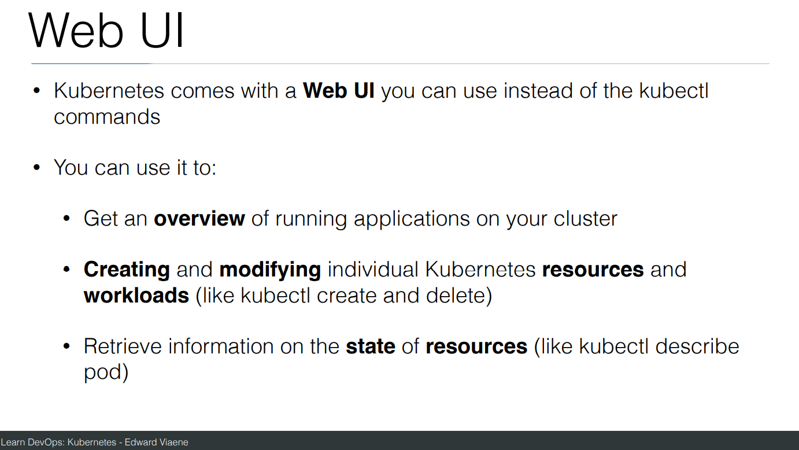

Slide 62
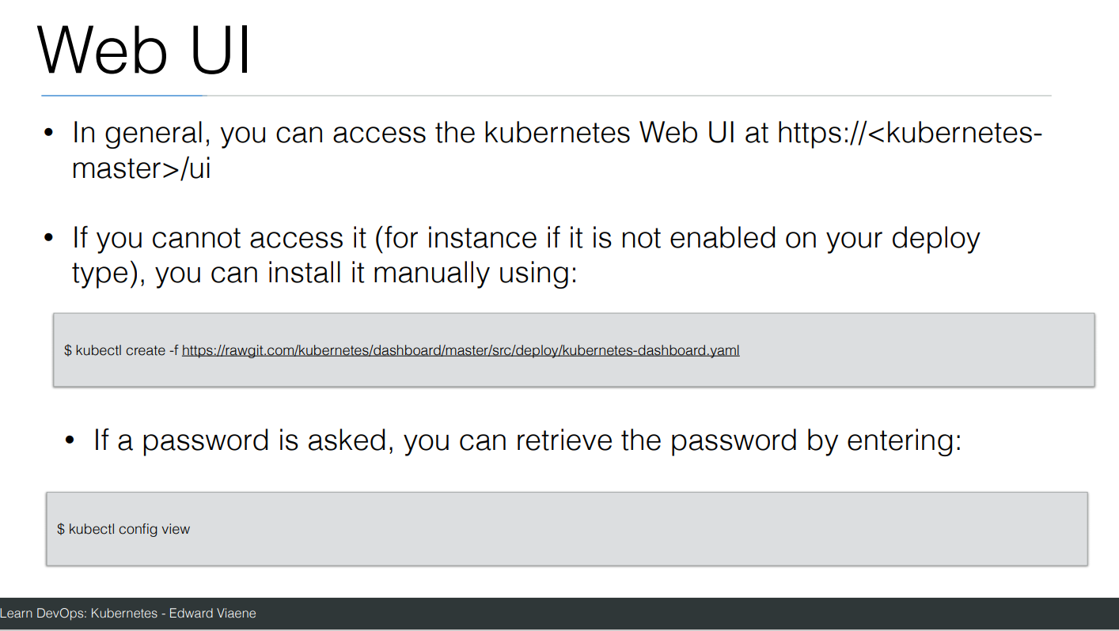

Slide 63
